Slide 1
Sales insights

Slide 2
About the project
Introduction​
Primary goals
Software used
Snapshot of project
​Expected outcome
​Abstract

Slide 3
Introduction
Sales Insights is a RollWorks feature that helps Sales Managers better prioritize accounts for outreach by using data science to uncover signals of account engagement. It provides account, and contact spiking insights to your sales team.

Slide 4
PRIMARY GOALS
The motto is to help businesses to grow exponentially. In order to grow businesses you need insight into the business. You can make a good strategy in only a case when you have a minute detail of your business. This app will help you to find insights and present them visually. So, you can see the performance of your business visually.
Sales analysis gives you the insights you need to dissect every aspect of your sales process. You can drill down into factors such customers, products, margins, revenues, volumes, budgets, targets, sales people, geographies, orders, deliveries, invoices and forward order books.
Having this level of sales analysis at the fingertips can allow you to keep much closer control over profitability and the overall performance of your business.

Slide 5
Software used

Slide 6
TableAu
Tableau was founded in 2003 as a result of a computer science project at Stanford that aimed to improve the flow of analysis and make data more accessible to people through visualization.
Tableau helps people and organizations be more data-driven
Continuously invested in research and development at an unrivaled pace, developing solutions to help anyone working with data to get to answers faster and uncover unanticipated insights.
This includes making machine learning, statistics, and smart data prep more useful to augment human creativity in analysis. And we not only offer a complete, integrated analytics platform, but also proven enablement resources to help customers deploy and scale a data-driven culture that drives resilience and value through powerful outcomes.

Slide 7
My sql workbench
MySQL Workbench is a unified visual tool for database architects, developers, and DBAs. MySQL Workbench provides data modeling, SQL development, and comprehensive administration tools for server configuration, user administration, backup, and much more. MySQL Workbench is available on Windows, Linux and Mac OS X.
Develop: MySQL Workbench delivers visual tools for creating, executing, and optimizing SQL queries. The SQL Editor provides color syntax highlighting, auto-complete, reuse of SQL snippets, and execution history of SQL.
Administer: Workbench provides a visual console to easily administer MySQL environments and gain better visibility into databases.

Slide 8
Snapshot of project

Slide 9
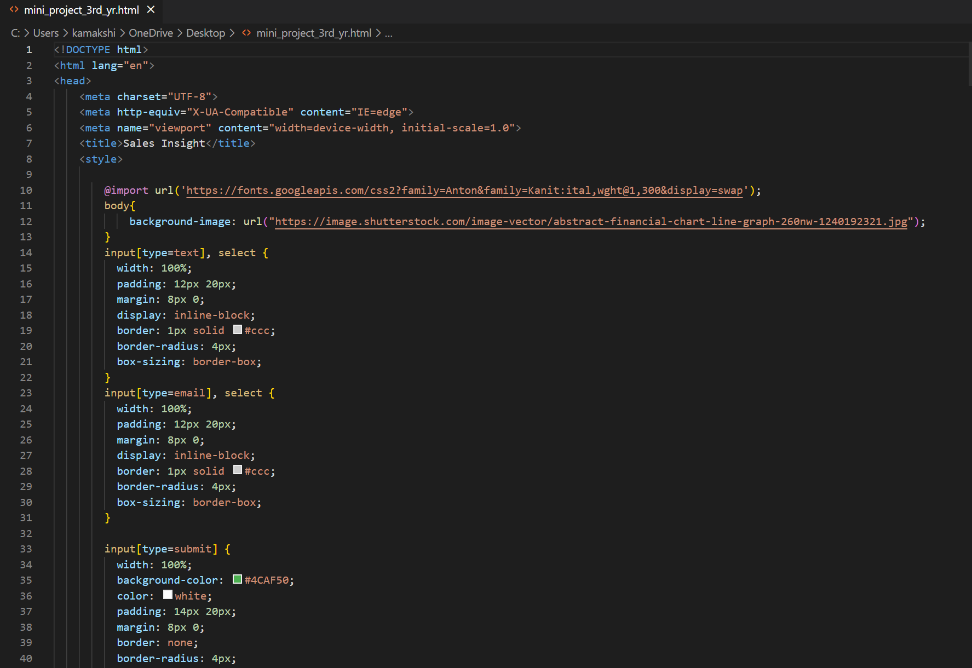
Code used to make the webpage

Slide 10
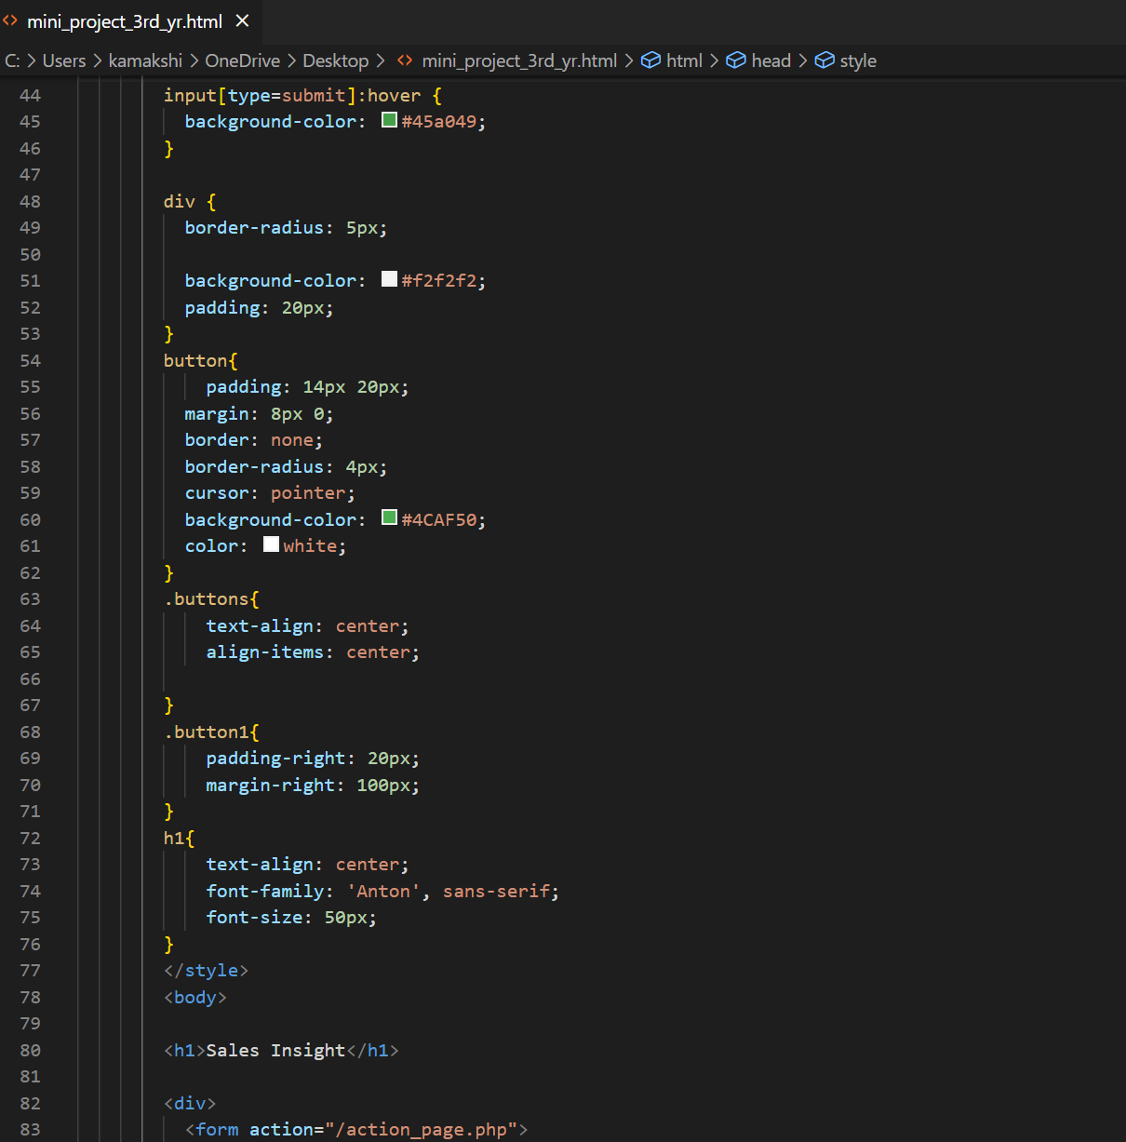
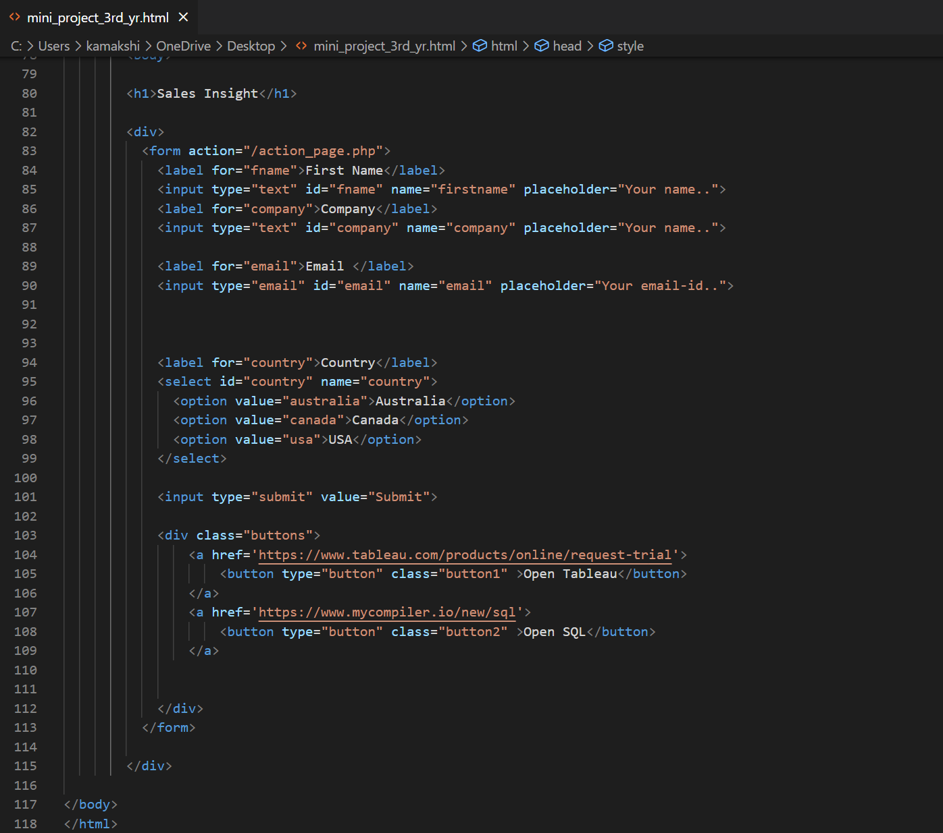

Slide 11
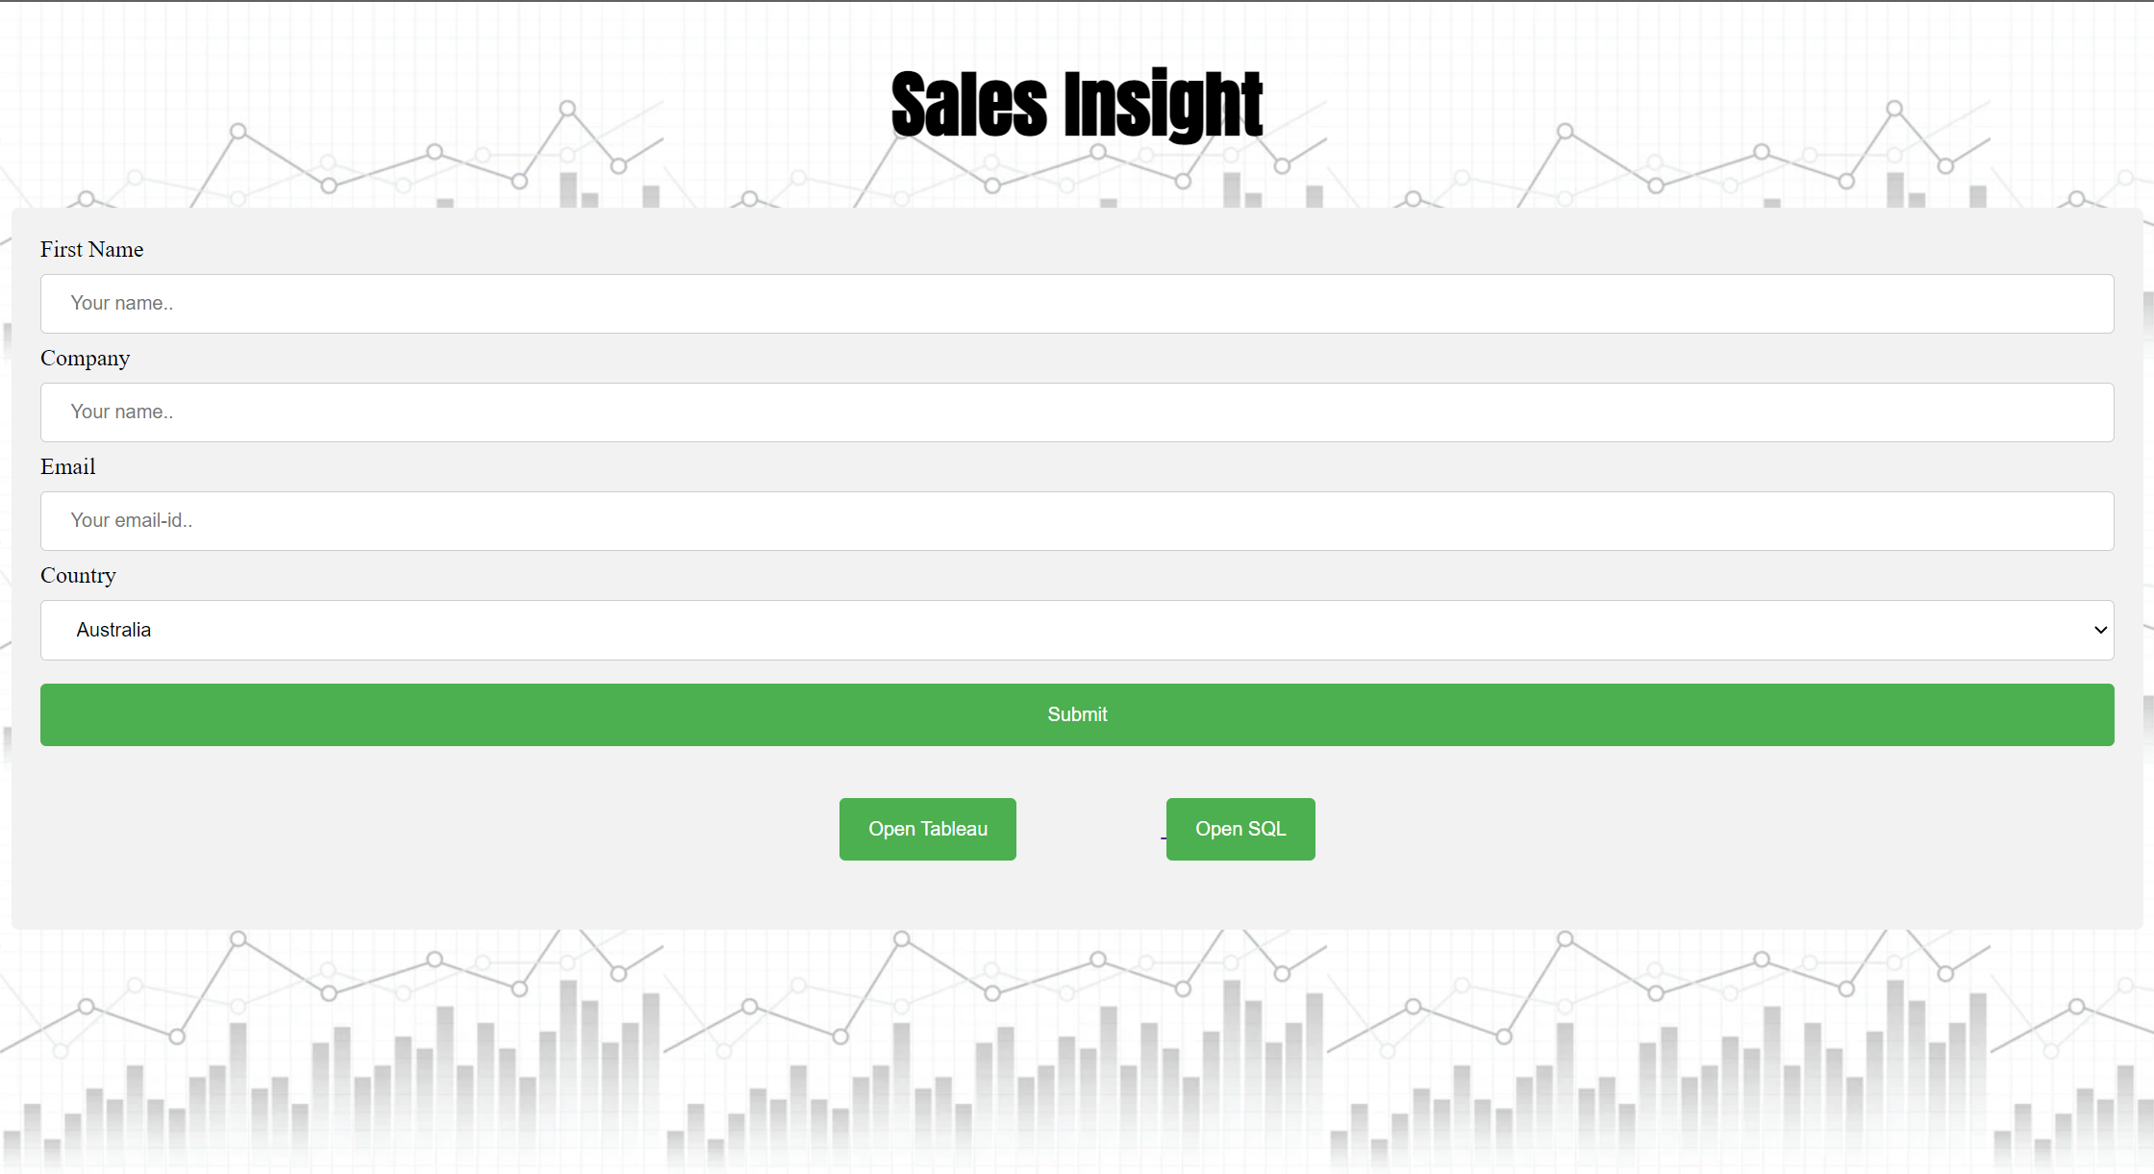
webpage
This is the webpage wherein the Client will be able to enter his details like:
1. Name
2. Company Name
3. Email
4. Country
He is then provided with two options:
Open SQL will redirect the user to the MY_SQL workpage wherein the client will be able to update the data set of his firm.
Open Tableau will present the dashboard for the user. Herein the user will be able to analyse the sales of his organisation.

Slide 12
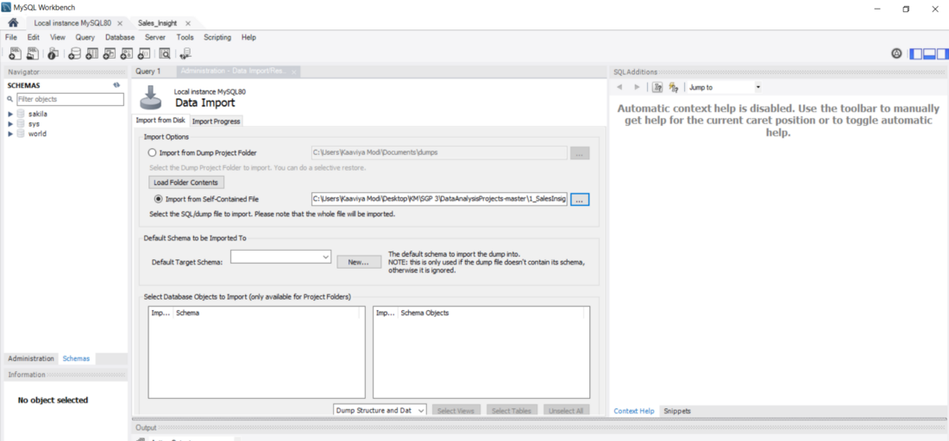
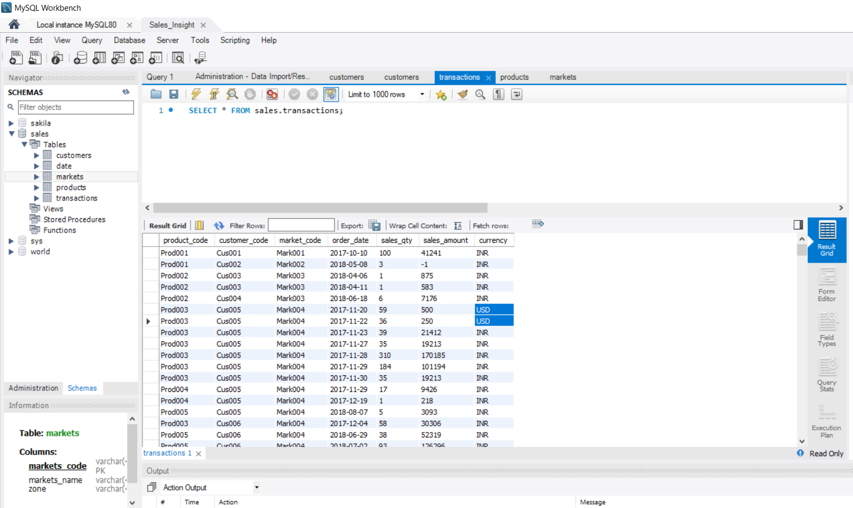
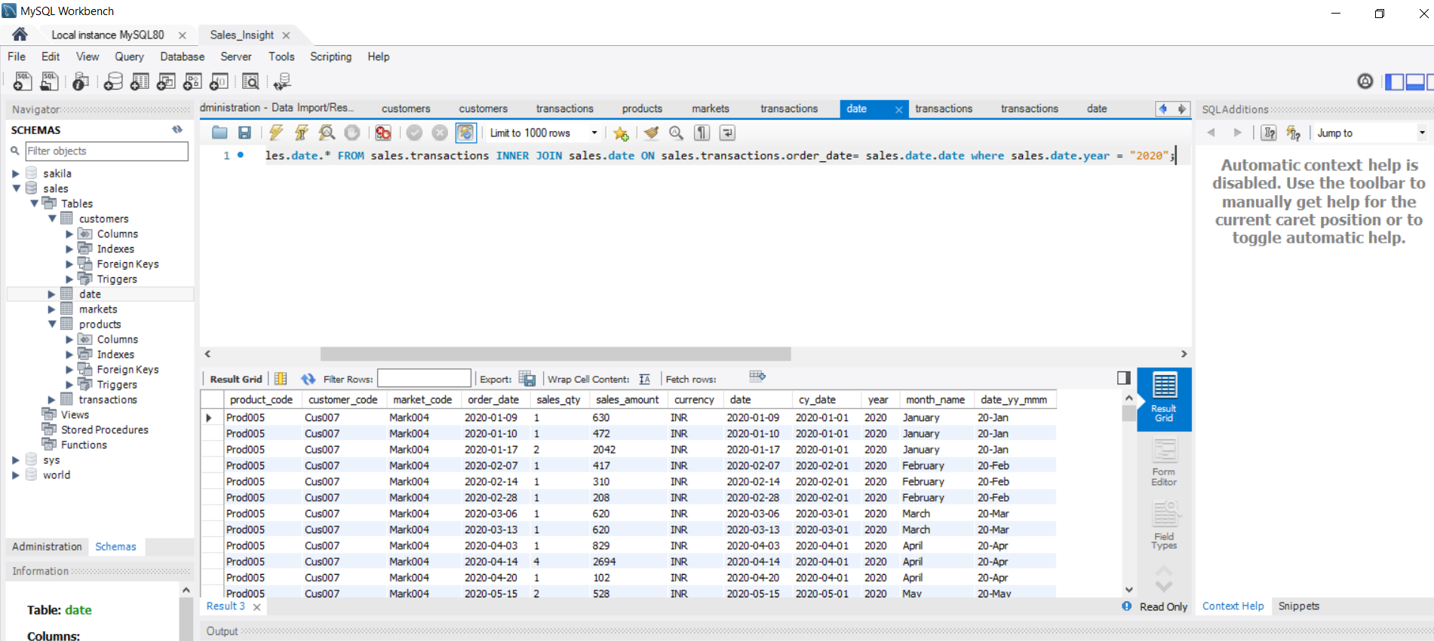
Mysql workbench
Data import
Data refining
Connecting with tableau
c

Slide 13
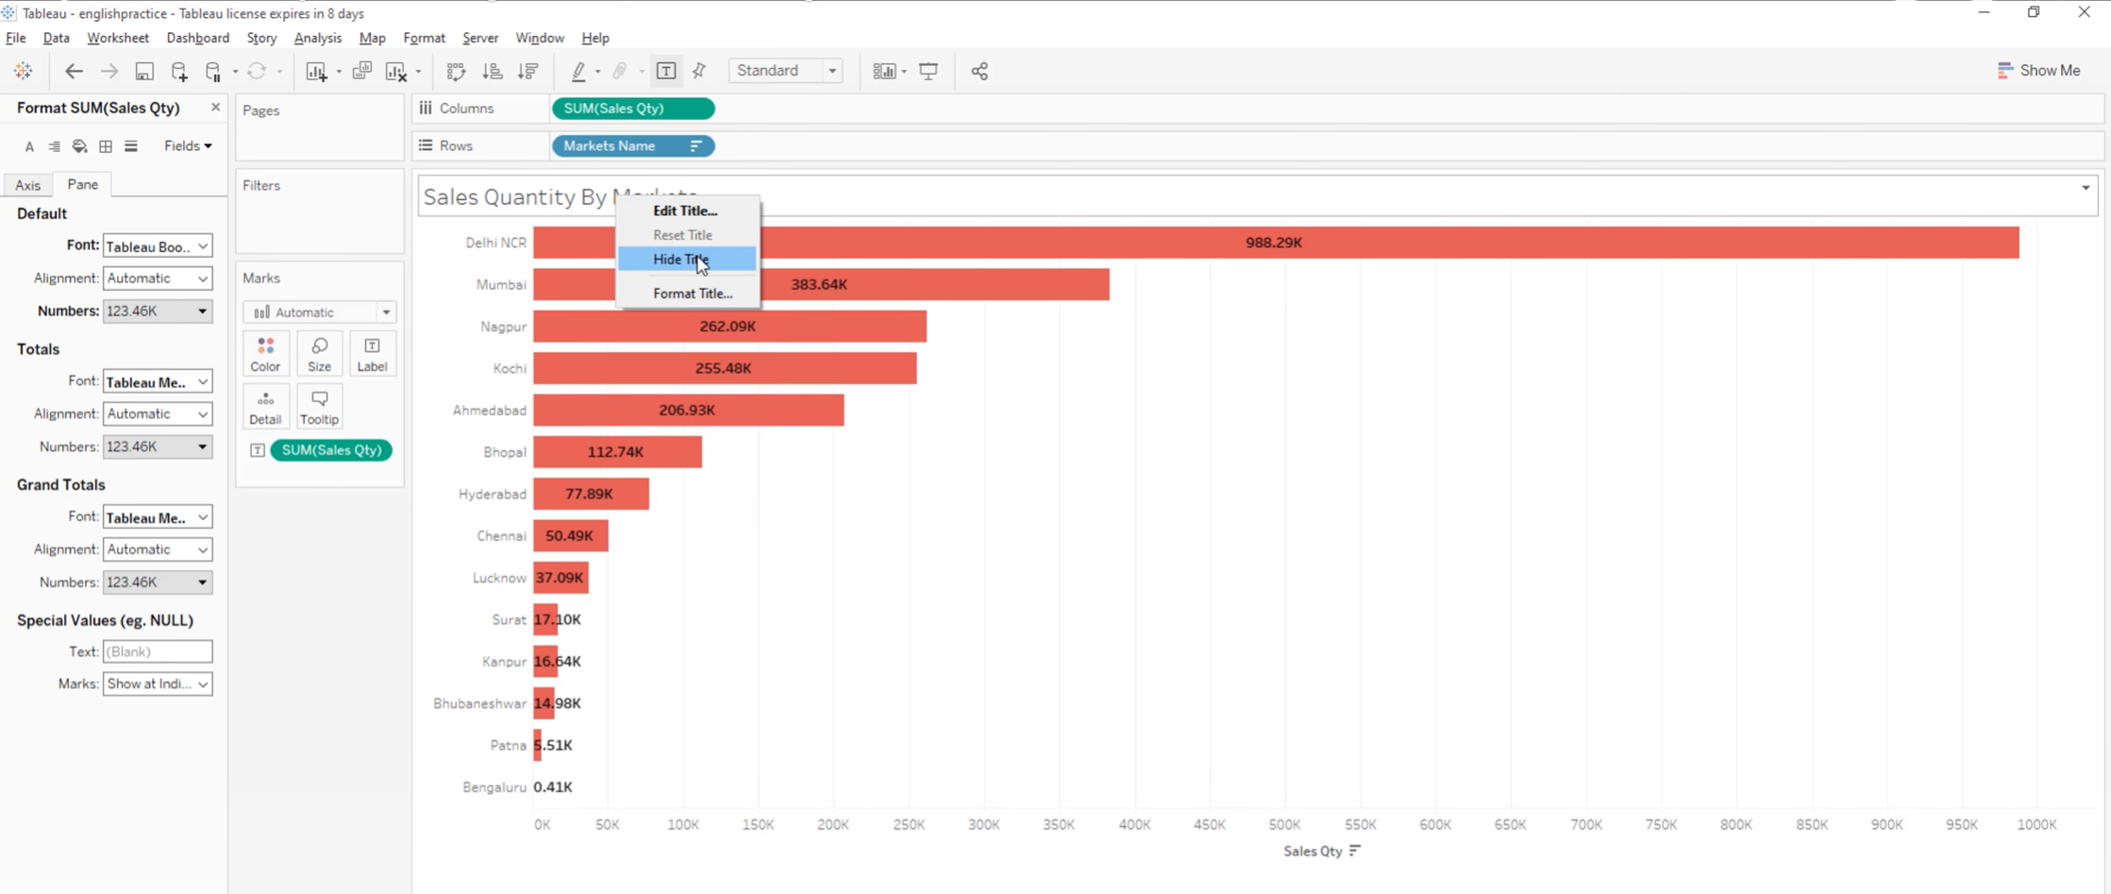
Tableau Worksheets

Slide 14
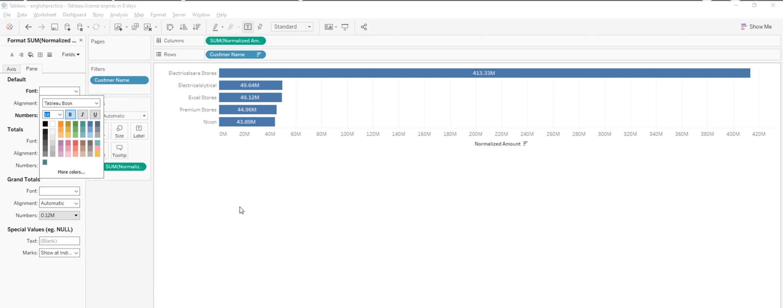

Slide 15
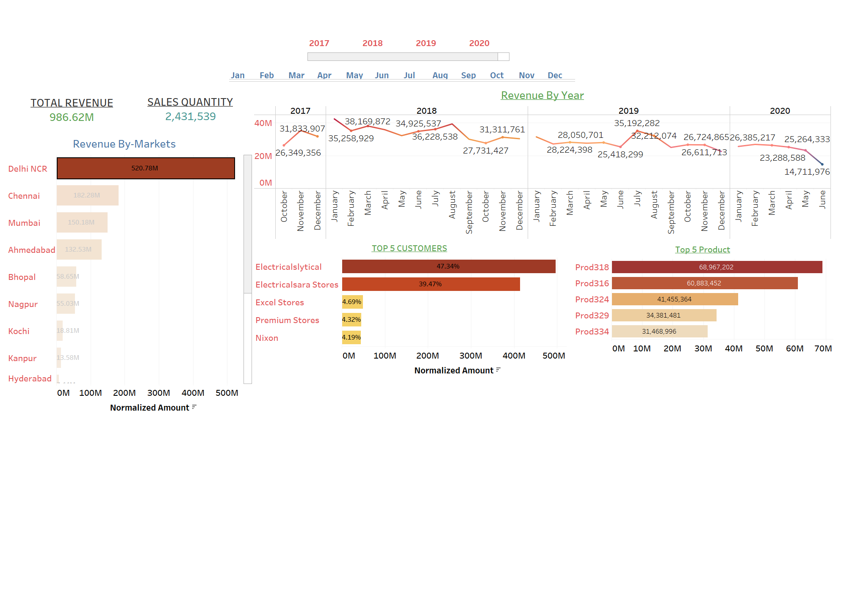
Tableau dashboard

Slide 16
Expected outcome
For new businesses, sales analytics is indispensable. As you begin to experience growth in the years ahead, you can express it in specifics — with numbers and stats to back you up — instead of using general terms.
Even if your company has been around for a few years, it’s never too late to start tracking your sales analytics. Having a long-term record of data also gives you more comparison points to look back on, such as how your company performed five, 10, or even 15 years ago.

Slide 17
AREAS OF FOCUS
B2B sales, or business-to-business sales
B2B are sales that occur between other buyers or services. They’re frequently more complex, involve more players, and take longer than B2C (business-to-consumer) sales. They also typically deal with larger amounts of revenue than B2C sales and tend to focus on long-term relationships rather than one-time purchases.
There are two main of types of B2B sales:
Supply sales: Businesses sell supplies needed to run other businesses (office supplies, cleaning supplies, etc.)
Distribution sales: Businesses sell products to distributors who will then sell that same product to the consumer (groceries, pharmaceuticals, Walmarts, etc.)
Service sales: Businesses sell services (tangible or digital) needed to run other businesses (consultants, software, etc.)
It’s worth noting that many B2B businesses can also deal in B2C sales. Office supply stores perform B2C transactions every day, but they also sell wholesale to businesses through their advantage program.
Enterprise sales (also called complex sales)
They are a type of B2B sale that specifically targets large companies. Enterprise sales come with high stakes. Most of them entail lengthy processes that end with a huge revenue deal, a complicated implementation, or a multi-cycle complex contract.
Because enterprise sales have such a long pipeline and can continue over many years, they frequently stop being about the products. When a business buys in an enterprise sale, it’s not just buying a product: it’s buying a system. That system comes with the product(s), support staff, a liaison, an implementation team, and a promise that future use of the product is dependent upon a healthy B2B relationship.
That isn’t to say other B2B sales can’t involve relationships or implementation. Enterprise sales simply refer to the negotiations and relationships with extraordinarily lucrative clients. A SaaS sale (discussed in the next section) to a general retailer ranks differently than a sale to a Fortune 500 company.

Slide 18
ABSTRACT
Importance of Sales analysis
Opportunities to Expand your Reach
By analyzing the sales data helps us to see the opportunities that we have missed or couldn’t claim it in the past and how we can achieve it in the future.
It also helps us to make better decisions like which product to keep (continue) and which to discontinue. Or rearrange market activities, change in the manufacturing process, inventory management and which scheme or offer to be launched or not.
Product Mix Analysis
Whenever a company plans to launch a new product; it is actually based on the sales analysis which tells us market trends and customer’s buying pattern. Sale analysis also tells the timing of the product to be launched, seasonally or off seasonal, holidays or festivals, because customer’s buying pattern changes depending upon the timing and situation.

Slide 19
Customer Analysis
It would be absolutely right if we say that sales analysis equals to customer analysis because it tells us the buying and shopping of our targeted customer and how he reacts to our product or service.
Decision Making
All the top management decisions are based on the sales analysis, for instance, if a product isn’t selling then the company will decide to discontinue the product. Back in 2005-2006, Nokia button pad phones were at their peak but the management of Nokia ignored sales analysis reports and growth of upcoming touchpad phones at the time. What happened? 10 years later, Samsung captured the whole market of touchpad phones which were once belonged to Nokia’s button pad phones. Why? Nokia’s management refused to make a decision based on the sales analysis report.

Slide 20
THANK YOU

